Slide 1
The Journey Starts

Slide 2
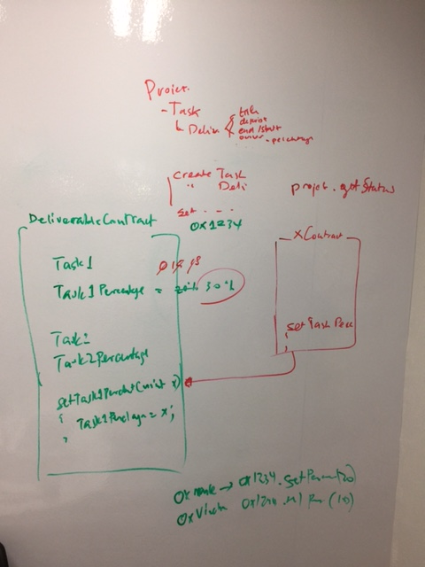
Milestone 1
2 localhost Blockchain nodes on Windows Notebook
5 Blockchains nodes on Linux and Windows

Slide 3
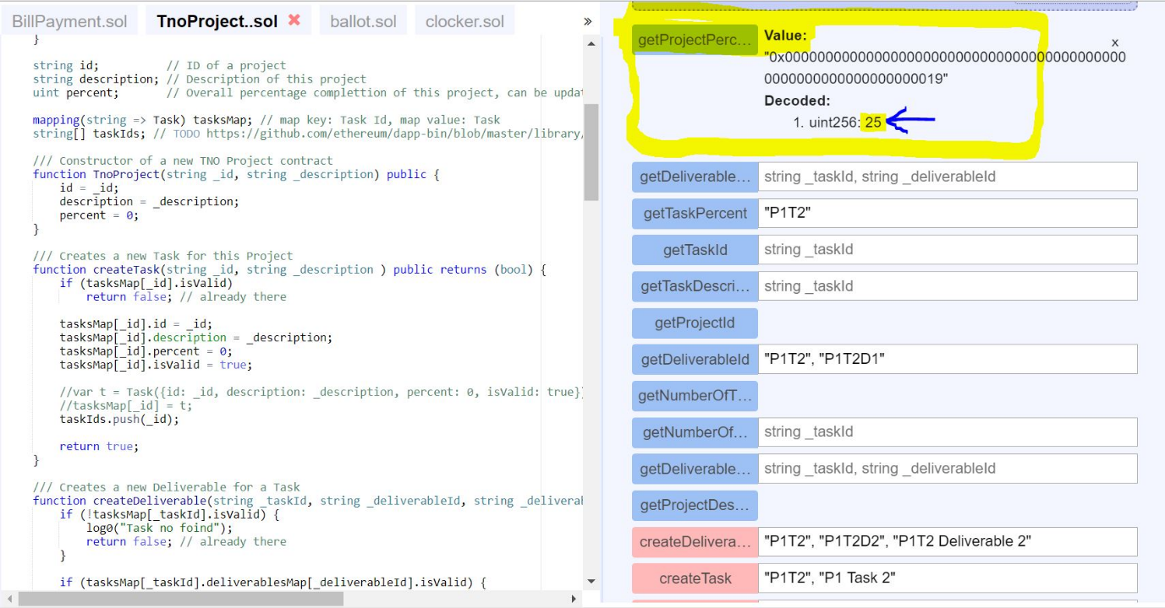
Milestone 2
Own Dog food Contract – Smart Contract for Project Tracking
UNIT TEST
=========
TnoProject: "P1", "Project 1"
createTask: "P1T1", "P1 Task 1“
createDeliverable: "P1T1", "P1T1D1", "P1T1 Deliverable 1"
createDeliverable: "P1T1", "P1T1D2", "P1T1 Deliverable 2"
createDeliverable: "P1T1", "P1T1D3", "P1T1 Deliverable 3"
setDeliverablePercent: "P1T1", "P1T1D1", 10
setDeliverablePercent: "P1T1", "P1T1D2", 20
setDeliverablePercent: "P1T1", "P1T1D3", 30
getTaskPercent == 20
creatTask: "P1T2", "P1 Task 2"
createDeliverable: "P1T2", "P1T2D1", "P1T2 Deliverable 1"
createDeliverable: "P1T2", "P1T2D2", "P1T2 Deliverable 2"
setDeliverablePercent: "P1T2", "P1T2D1", 20
setDeliverablePercent: "P1T2", "P1T2D2", 40
getTaskPercent == 30
getProjectPercent == 25

Slide 4
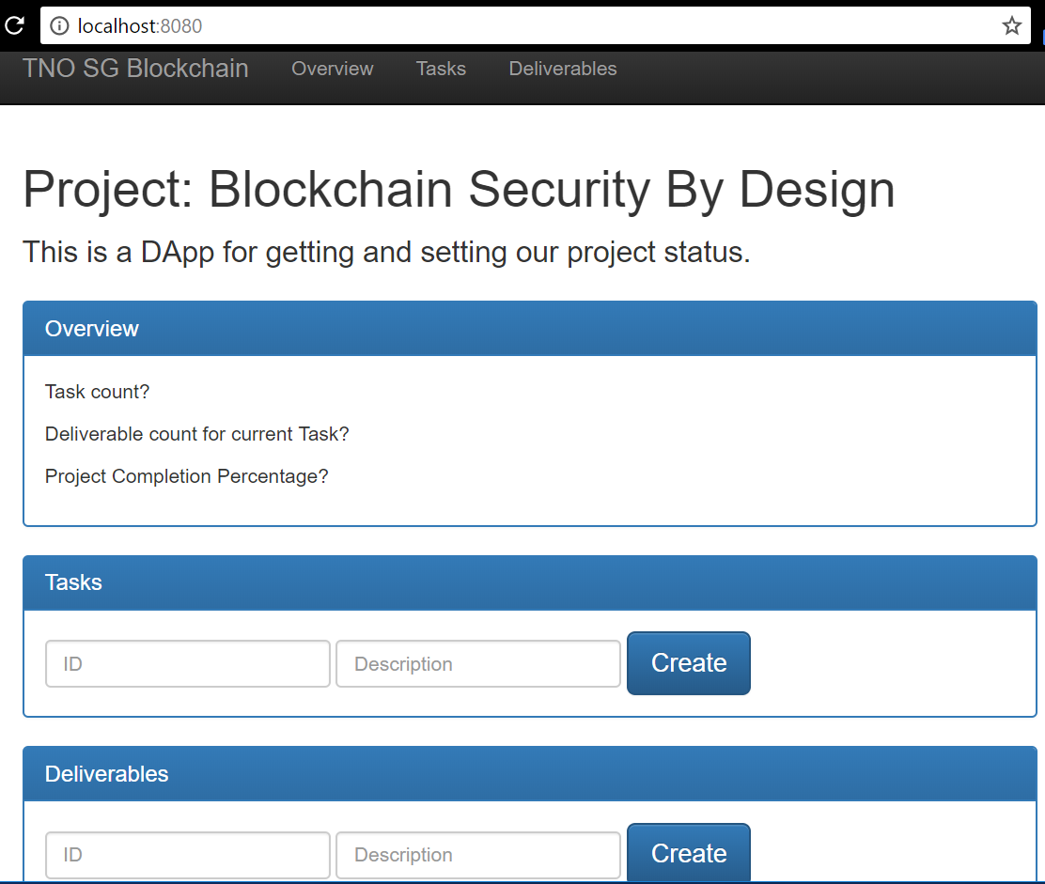
Milestone 3
DApp

Slide 5
Basic Technology Stack Identified
Geth
Solidity, Javascript, Go-lang
Truffle
DApp (Bootstrap etc.)
TestNet

Slide 6
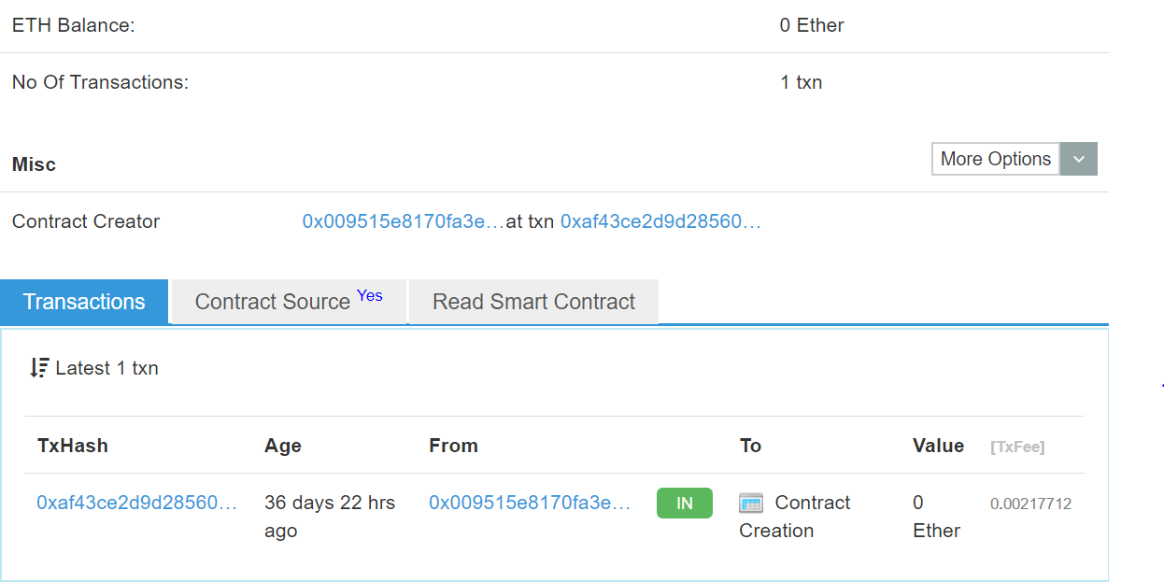
Milestone 4
TestNet – Deployed dummy contract on TestNet using Parity client
NOTE: You can use other clients, even your own geth if you want to manage own account and scripts.
https://ropsten.etherscan.io/address/0x2942238EA7A7376D504b15E9b8ab6e9c37A179a0

Slide 7
Milestone 5
DAO Smart Contract Attack Simulation
Refer to DAO Smart Contract Attack.docx

